Slide 1


-Dictionary

Slide 2
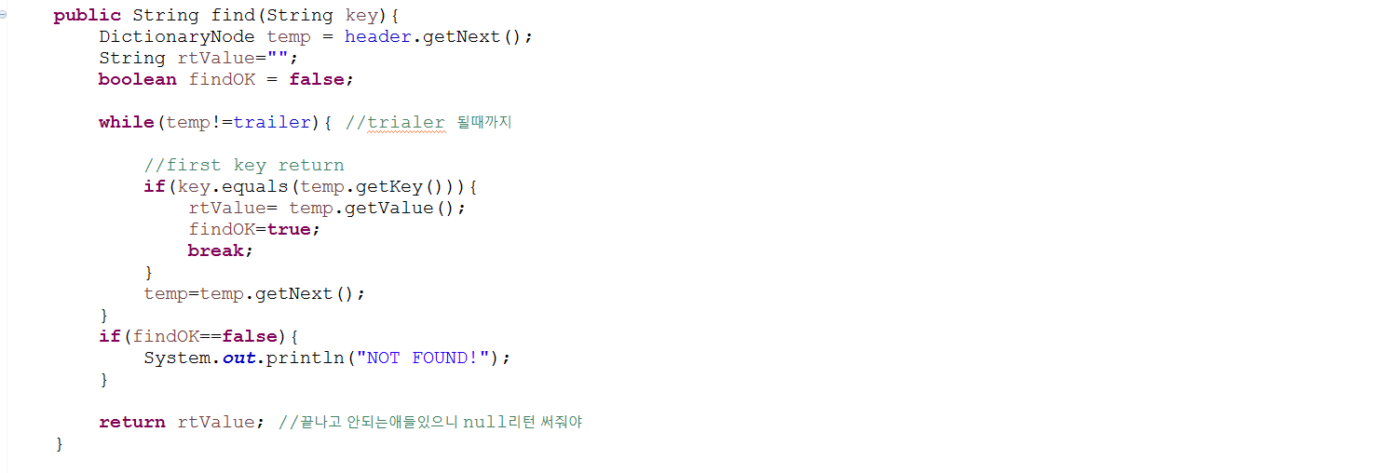
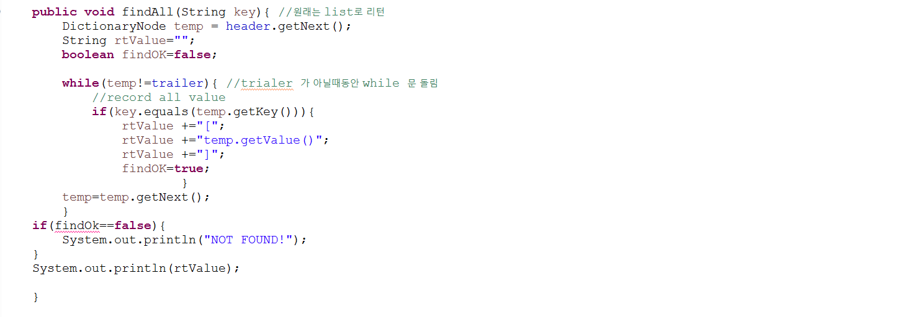
-Dictionary

Slide 3

-Dictionary

Slide 4
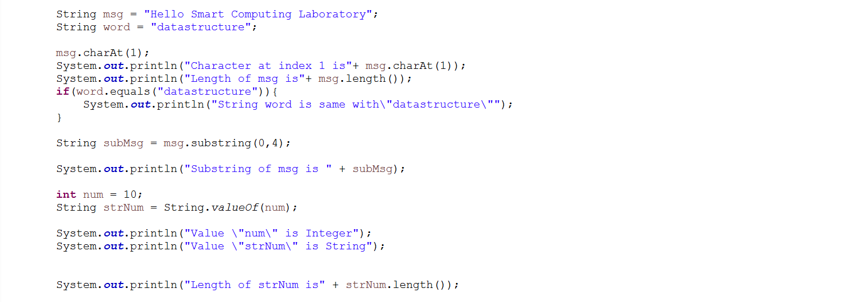
-String

Slide 5



Slide 6
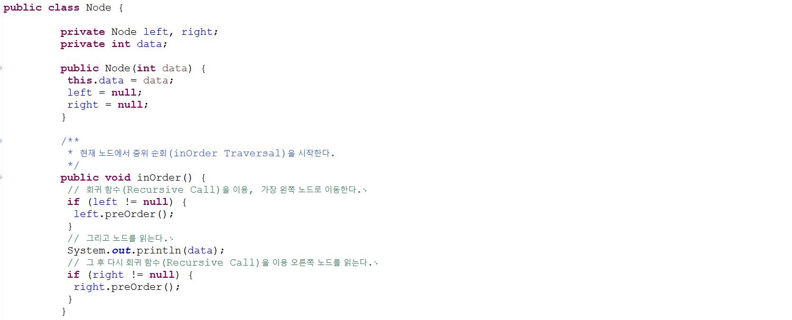
-BSTNode

Slide 7
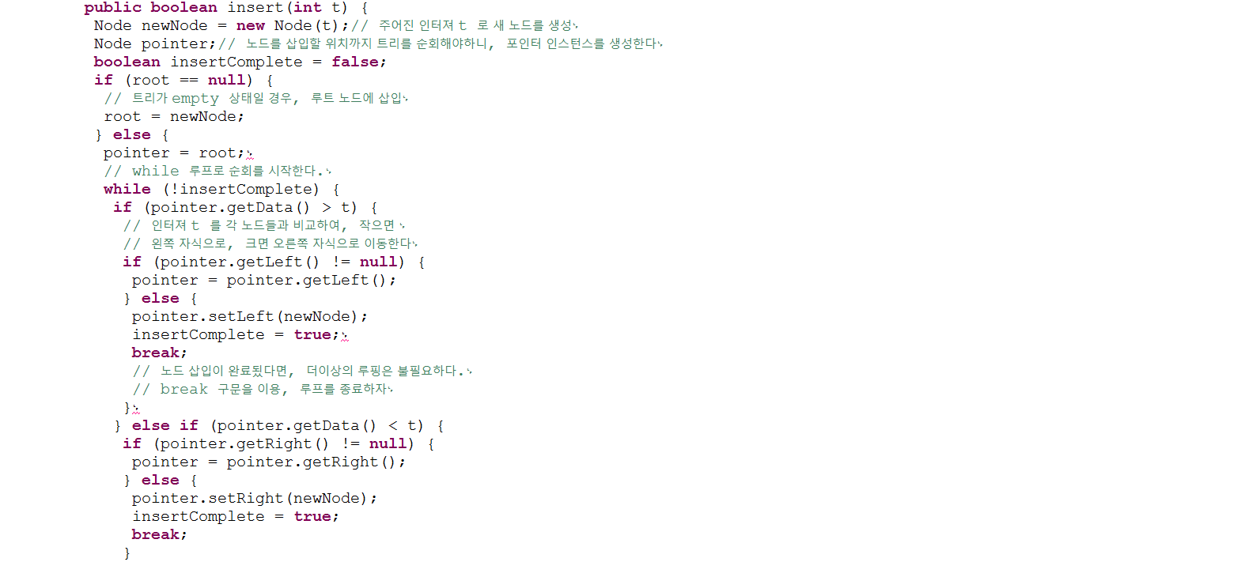


Slide 8


Slide 9
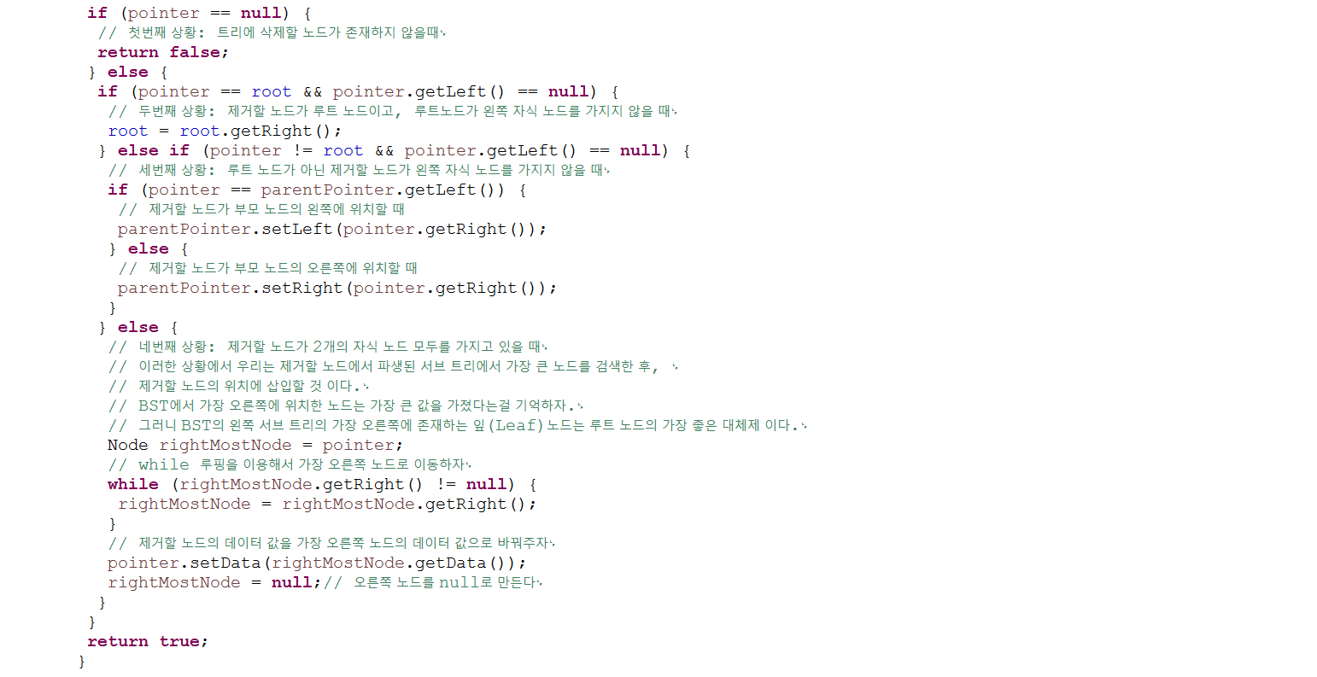

Slide 10
